Slide 1
SUPERVISED MACHINE LEARNING
CLASSIFICATION
TING CHONG NA
28.05.2023

Slide 2
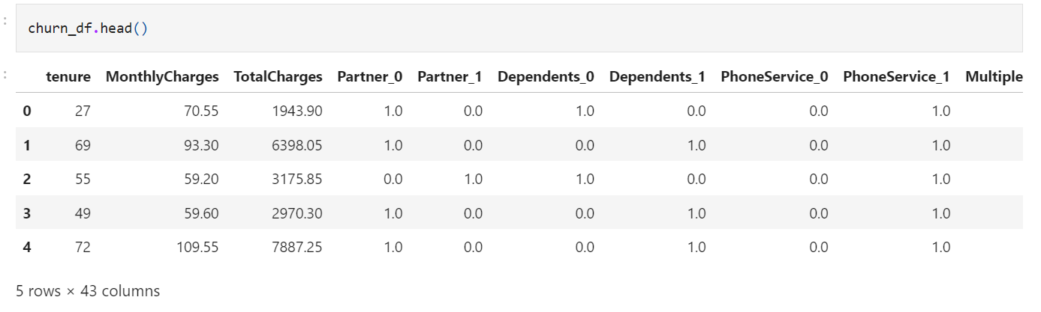
Data Description
TOPIC: Predicting Customer Churn
Objective: Predicting customer churns (leaving the business) of a telecom company
This dataset is processed and contains 42 features about a customer's telcom service types, tenure, charges, and payments. Based on such features, we would like to predict if a customer is leaving the business or not (churn).
y=0 : Non-Churn
y=1 : Churn

Slide 3
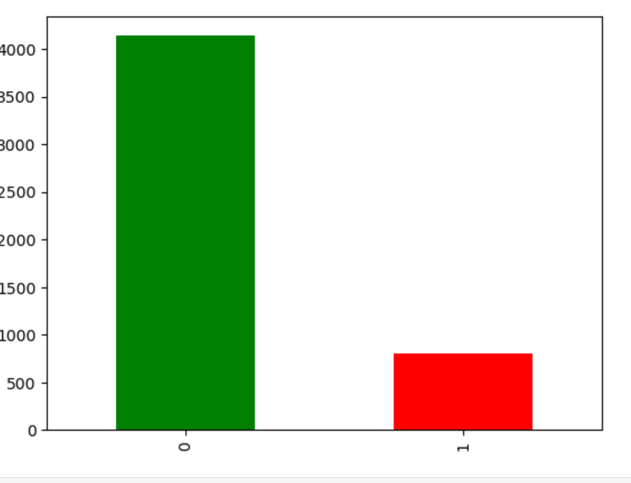
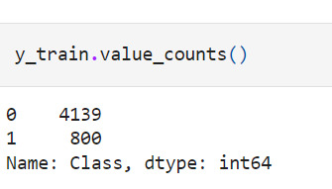
Data Analysis
An Imbalanced Dataset
The non-churn customers (4139) are almost 4 times more than the churn customers (800)

Slide 4
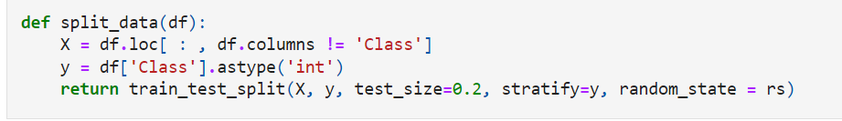
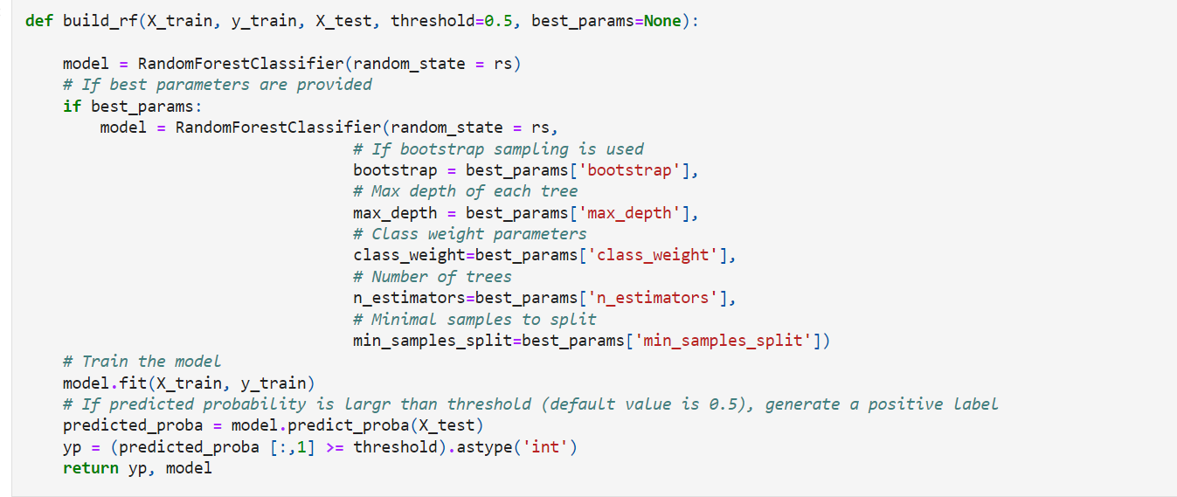
Model: Random Forest Classifier
Train a regular random forest classifier without any add-ons (class weights or resampling)
Train Test Split
Random Forest Classifier Model

Slide 5
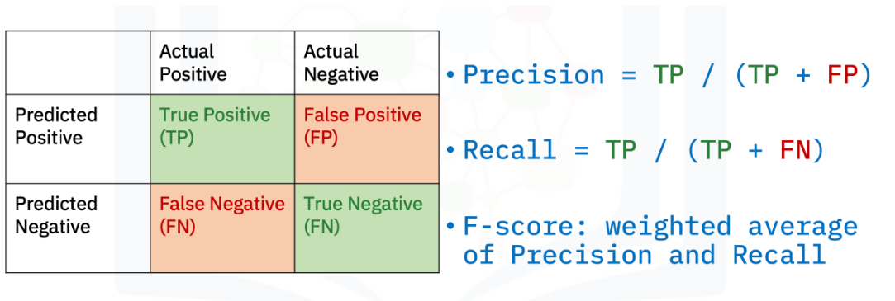
Robust Evaluation Metric
For binary classification
Precision
Percentage of accurately predicted positive instance
Recall
Percentage of successfully recognized positive instances
Fscore
Weighted Average of precision and recall to evaluate the model

Slide 6
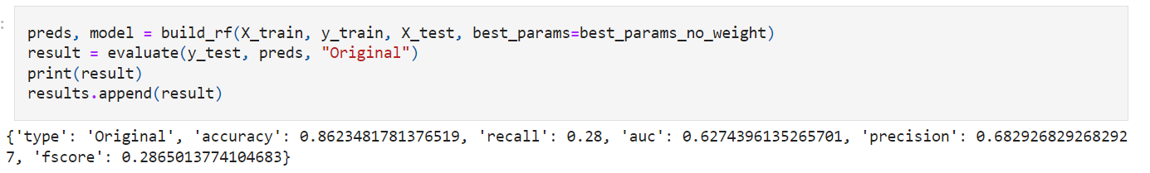
Model: Random Forest Classifier
RESULTS:
High Accuracy (0.86)
Low Recall (0.28)
To Improve Performance:
1. Add class re-weighting
2. Resampling: SMOTE and Undersampling

Slide 7
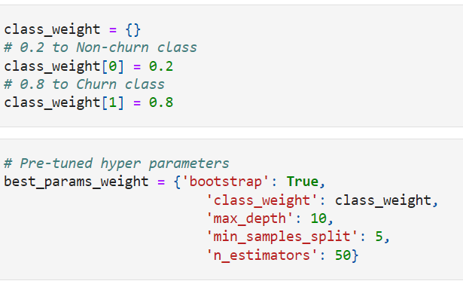
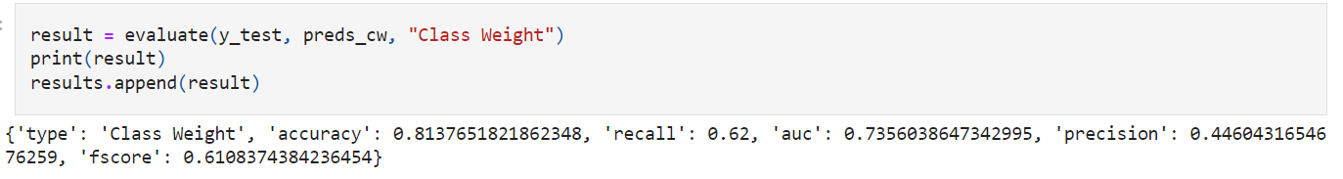
Model: Add class re-weighting
Add class weights to the RFC with pre-tuned weight 0.8 to churn class and weight 0.2 to non-churn class
Evaluate the refined model

Slide 8
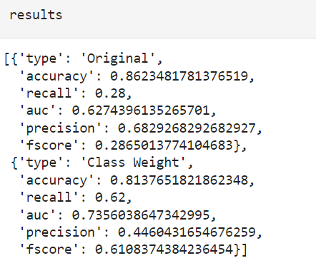
Model: Add class re-weighting
IMPROVEMENT
Recall increased from 0.28 to 0.62
Fscore increased from 0.29 to 0.61
Add Class Reweighting is effective for the imbalanced customer churn dataset.

Slide 9
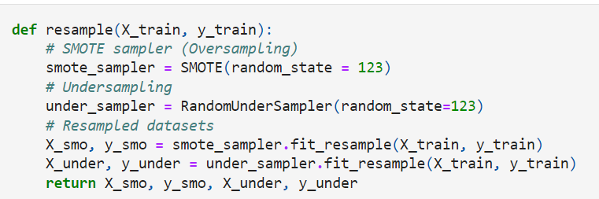
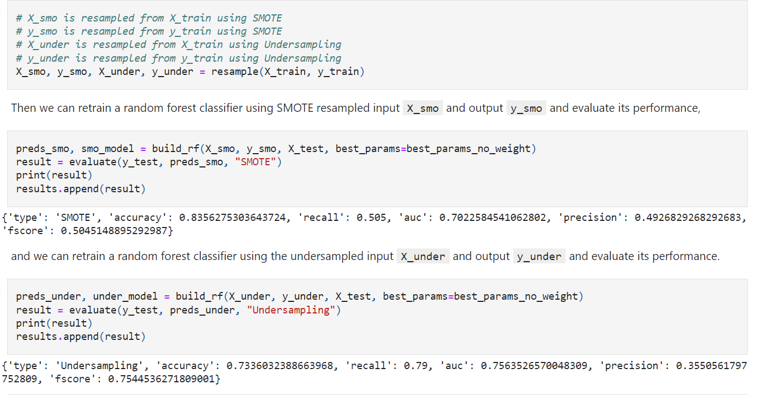
Model: Resampling SMOTE and Undersampling
Use resampling SMOTE and undersampling
Evaluate the refined model

Slide 10
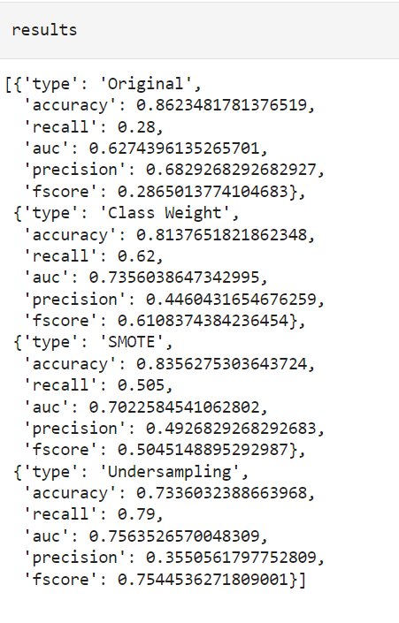
Model: Resampling SMOTE and Undersampling
IMPROVEMENT
For Resampling SMOTE
Recall increased to 0.505
Fscore increased to 0.50
For Undersampling
Recall increased to 0.79
Fscore increased to 0.75
Resampling SMOTE and Undersampling is effective for the imbalanced customer churn dataset.

Slide 11
Model: Compare Results
Compare the performance among different random forest models:
Model trained with Random Forest Classifier
Model with Class Weights
Model trained with Resampling SMOTE
Model trained with Undersampling

Slide 12
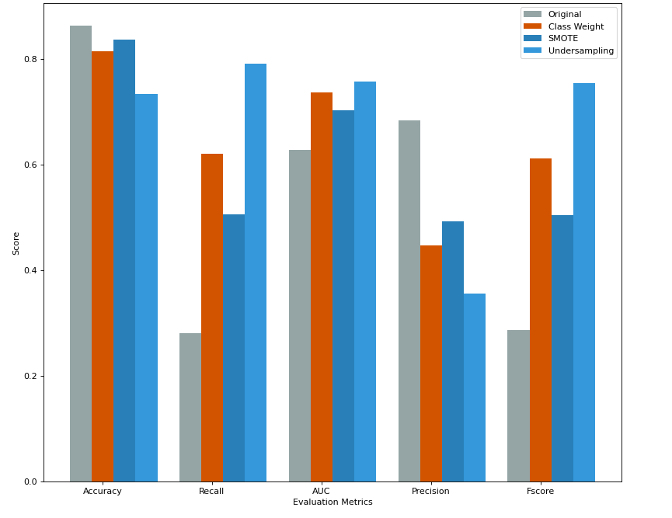
Model: Compare Results
Accuracy
All models have high accuracy.
Recall
Improved with Class Weights, Resampling and Undersampling.
Undersampling produces the highest recall.
AUC
Improved with Class Weights, Resampling and Undersampling.
Undersampling produces the highest AUC.
Precisions
Decreased with Class Weights, Resampling and Undersampling
(increased false positives)
Fscore
Improved with Class Weights, Resampling and Undersampling. Undersampling has the highest Fscore.

Slide 13
Conclusion
By analyzing the bar chart above, Undersampling seems to be the best method to help alleviate the imbalanced challenge in the customer churn dataset.
Although all Class Weights, Resampling and Undersampling decreased the Precision (increased false positives) but sometimes it is not a bad idea to assume some customers are about to leave as motivation to improve services.

